Slide 1
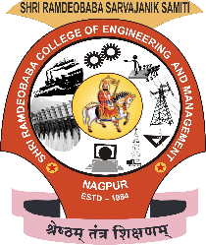
Shri Ramdeobaba College of Engineering & Management, Nagpur Department of Computer Science & Engineering V Semester CSE (Section B) Software Technology Lab Synopsis

Slide 2
Photo OCR
Optical Character Recognition

Slide 3
Team Members
Name
Roll no.
Aishwarya Mohbansi 1
Kalyani Uttarwar 13
Aniruddha Tapas 38
Arjun Sangitrao 41
Rakesh Chandra 67

Slide 4
Introduction
Photo OCR stands for Photo Optical Character Recognition.
With the growth of digital photography and more recently the growth of camera in our cell phones we now have tons of visual pictures that we take all over the place. And one of the things that generates curiosity is how to get our computers to understand the content of these pictures a little bit better.

Slide 5
Problem Definition
The Photo OCR problem focuses on how to get computers to read the text to the purest in images that we take. And after it successfully does that it then it'll come up with these transcriptions of what is the text that appears in the image.

Slide 6
What is Photo OCR ?
OCR stands for Optical Character Recognition. It is one such system that allows us to scan printed, typewritten text (numerals, letters or symbols) and/or convert scanned image into a computer process able to format either in the form of a plain text or a word document.
Later the converted documents can be edited, used or reused in other documents. Thus the documents become editable.

Slide 7
…Continued.
OCR is used when recreating a similar document in paper as a document in electronic form takes more time.
The converted text files take less space than the original image file and can be indexed. Hence the use of OCR adds an advantage to the user who had to deal with conversion of great amount of paper works in to electronic form.

Slide 8

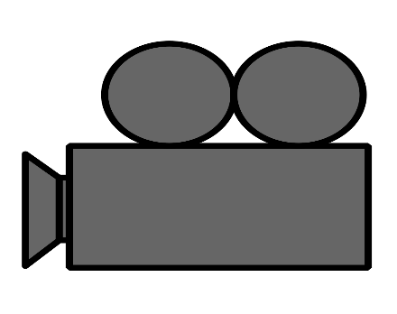

Slide 9
Segmentation

Slide 10

S I M P L E
T E X T

Slide 11
Text Document
SIMPLE TEXT

Slide 12
When and Why OCR ?
OCR is used when recreating a similar document in paper as a document in electronic form takes more time.
The converted text files take less space than the original image file and can be indexed. Hence the use of OCR adds an advantage to the user who had to deal with conversion of great amount of paper works in to electronic form.

Slide 13
Proposed Plan of Work
Go through the image and find the regions where there's text and image.
Give a rectangular frame around that text region, so we can then do character segmentation, where we might take this text box and try to segment it out into the locations of the individual characters.

Slide 14
…Continued.
Finally, having segmented out into individual characters, we can then run a crossfire, which looks at the images of the visual characters, and tries to figure out the subsequent characters in the text.
The recognized text would then be displayed on the output screen where it would be cross-checked.

Slide 15
Methodology
Learning fundamentals machine learning.
Learning coding in MATLABs.
Implementing algorithm for Text Detection.
Implementing algorithm for Character Segmentation.
Implementing algorithm for Character Recognition.
Designing a pipeline to implement all these modules together.
Building the User Interface.
Including additional features to software.
Testing of software.

Slide 16
Benefits
No more retyping
Quick digital searches
Edit text
Save space
Accessibility

Slide 17
OCR Pipeline

Slide 18
Modules
The Modules that were identified in the Optical Character Recognition system are as follows:-
Document Processing
MATLAB Programming
Document Recognition
Document Editing and
Document Searching

Slide 19
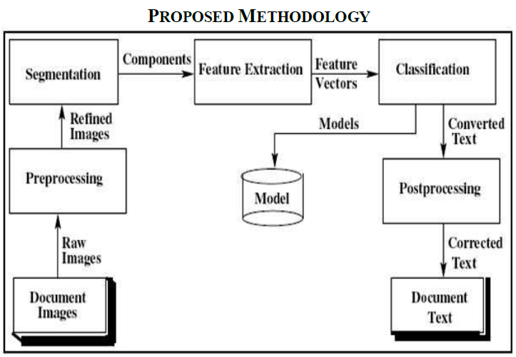
Design of OCR
The design of our OCR system can be best explained with the following diagram:-

Slide 20
Technology for Implementation
Technology used: - Machine learning
Tools: - MATLABs.
Operating system: -works on Windows OS (7 or higher).
Hardware: - Processor having minimum 512 GB of RAM, 300 MHz

Slide 21
Conclusion
The Grid infrastructure used in the implementation of Optical Character Recognition system can be efficiently used to speed up the translation of image based documents into structured documents that are currently easy to discover, search and process.
The automated entry of data by OCR is one of the most attractive, labor reducing technology.
The recognition of new font characters by the system is very easy and quick.
We can edit the information of the documents more conveniently and we can reuse the edited information as and when required.
The extension to software other than editing and searching is topic for future works.

Slide 22
Future Work
Training and recognition speeds can be increased greater and greater by making it more user-friendly.
Many applications exist where it would be desirable to read handwritten entries. Reading handwriting is a very difficult task considering the diversities that exist in ordinary penmanship. However, progress is being made.

Slide 23
Thank you !!!

